Slide 1
Group 5 Project Presentation
By: Cameron Harter, Matthew Herrmann, and Angel Perez

Slide 2
Program Structure
Flow Chart & explanation of the Structure

Slide 3
Part 1: Static Blog
Receive request from web browser
Define structure of blog post
Create list of blog posts
Convert blog post list to HTML
Render request in HTML
OBJECTIVES

Slide 4
Part 1: Static Blog
request
start
render-blog-page
Comes from the user’s web browser
Required to start the webpage
response-generator
render-posts
HTML structure of blog page
Converts list of posts into HTML
BLOG
A global list of posts
render-post
Renders post into an HTML
post
The main structure of a blog post

Slide 5
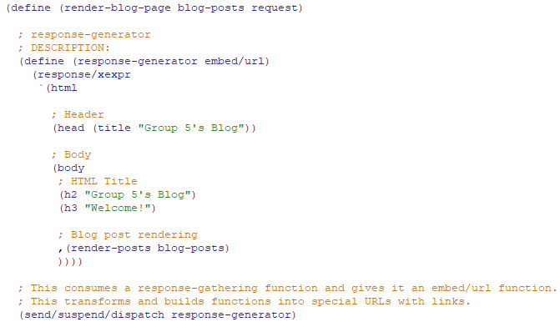



Racket Code of the Blog (1. Creating the Static Blog)
BLOG
post
render-blog-page
render-posts
render-post
start

Slide 6
Present Program Part 1

Slide 7
Part 2: Adding Posts
Create form for adding a post
Create handler for submitting form
Parse input from handler
Extract bindings from request
Create a new post using the bindings
Re-render page using new list
OBJECTIVES

Slide 8
Part 2: Adding Posts
request
start
render-blog-page
Comes from the user’s web browser
Required to start the webpage
response-generator
render-posts
HTML structure of blog page
Converts list of posts into HTML
BLOG
A global list of posts
insert-post-handler
render-post
Handles how posts are added
Renders post into an HTML
post
The main structure of a blog post
parse-post
new-post-form
Parses request to create a new post
Renders form for creating a new post

Slide 9
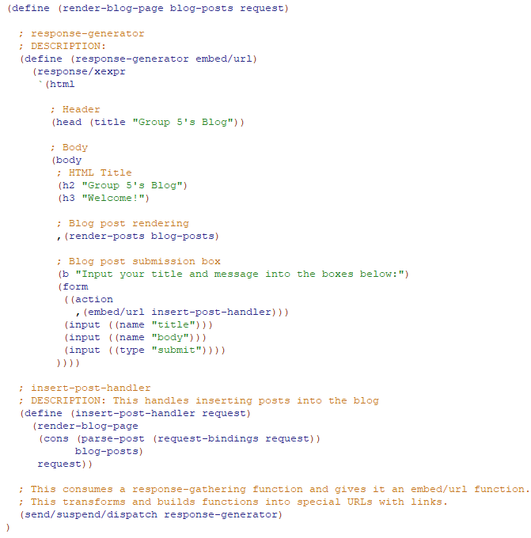

Racket code of the Blog (2. Adding new posts)
Edited: response-generator
New: parse-post

Slide 10
Present Program Part 2

Slide 11
Part 3: Share Posts Between Browsers
Make blog list mutable
Add new post to blog list
Delete old re-render code
OBJECTIVES

Slide 12
Part 3: Share Posts Between Browsers
request
start
render-blog-page
Comes from the user’s web browser
Required to start the webpage
response-generator
render-posts
HTML structure of blog page
Converts list of posts into HTML
BLOG
A global list of posts
Edit: No longer static
insert-post-handler
render-post
Handles how posts are added
Edit: Delete re-render
Renders post into an HTML
blog
A mutable list of posts to save and share between browsers
parse-post
new-post-form
Parses request to create a new post
Renders form for creating a new post
post
The main structure of a blog post
blog-insert-post!
Adds a new blog post in the top of the blog

Slide 13
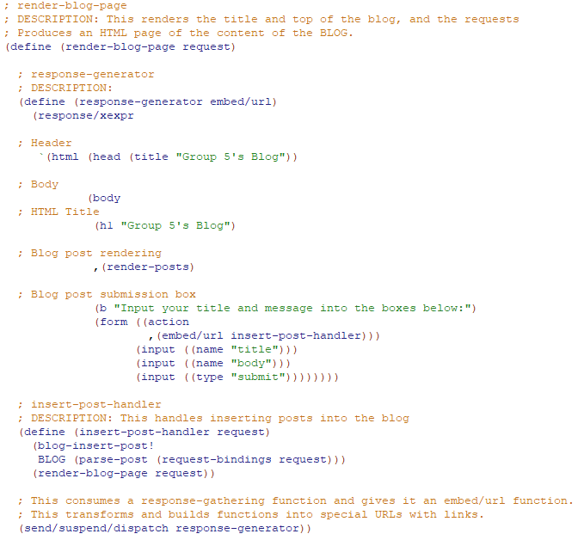



Racket Code of the Blog (3. Share posts between browsers)
Edited: render-blog-page
Edited: blog-insert-post!
New: blog
Edited: BLOG
(part-2: insert-post-handler)

Slide 14
Present Program Part 3

Slide 15
Part 4: Adding Comments To Posts
Allow posts to store list of comments
Add post detail page
Render comments list in HTML
Add form for new comments
Parse new comment from request
Append new comment to comment list
OBJECTIVES

Slide 16
Part 4: Adding Comments To Posts
request
Comes from the user’s web browser
start
render-blog-page
render-post-detail-page
Required to start the webpage
response-generator
render-posts
response-generator
render-as-itemized-list
HTML structure of blog page
Converts list of posts into HTML
HTML structure of post detail page
Converts list of comments into an HTML unordered list
BLOG
A global list of posts
insert-post-handler
render-post
insert-comment-handler
render-as-item
Handles how posts are added
Renders post into an HTML
Handles how comments are added
Renders the comment into an HTML list item
blog
view-post-handler
A mutable list of posts to save and share between browsers
parse-post
Makes the link to the post-detail-page
parse-comment
Parses request to create a new post
Parses request to create a new comment
new-comment-form
Renders form for creating a new comment
post
new-post-form
The main structure of a blog post
Edit: Added comments
blog-insert-post!
Renders form for creating a new post
post-insert-comment!
Adds a new blog post in the top of the blog
Adds a new comment under blog post

Slide 17
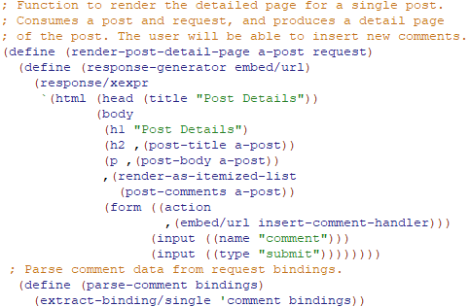
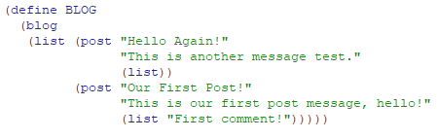

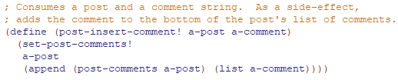
Racket code of the Blog (4. Adding comments to posts)
Edited: post
Added: render-post-detail-page
Edited: BLOG
Added: insert-comment-handler
Added: post-insert-comment!

Slide 18
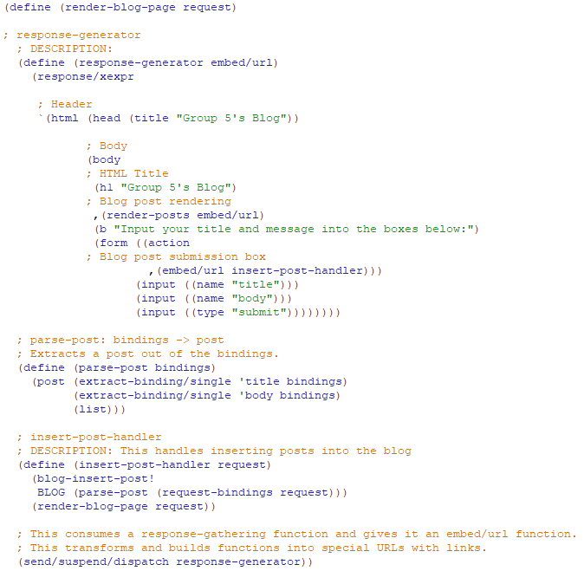
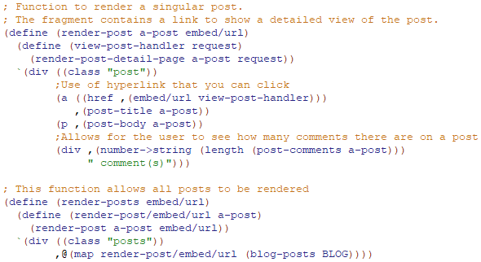
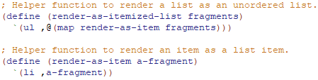
Racket code of the Blog (4. Adding comments to posts)
Edited: render-blog-page
Edited: render-post & render-posts
New: render-as-itemized-list & render-as-item

Slide 19
Final Website Demo

Slide 20
Lessons / Challenges

Slide 21
Learning #lang web-server/insta
This library requires the start definition to operate.
Without it, the website will refuse to run.
Understanding the new library’s syntax
(send/suspend/dispatch) handles multiple continuations of a page asynchronously.
(extract-bindings/single) extracts the content out of a request.
(embed/URL) embeds a URL in the HTML code.

Slide 22


Racket is picky on quotation
When referring to a struct variable, use ‘ (Single-quote)
When referring to HTML code use ` (Back-tick)

Slide 23
Racket is full-stack (THE all-in-one package)
No JavaScript, HTML, or CSS files are needed
Racket doesn't work with other files
Racket is only needed

Slide 24
“Rendering”
Rendering is a fancy word for converting
Requests are “rendered” to HTML code
Some rendering functions are done with looping (with map)
Rendering posts
Unordered lists
Ordered lists

Slide 25
Thank You!

